Slide 1
The Uncanny Mandelbrot

Slide 2
Description
The Mandelbrot Set is pretty well-known, but I wondered: what can it be used for? Turns out, other than maybe being a good way to simulate landmasses w/ coastlines, it’s aesthetic. A little disappointing, but I decided to go all-in on its unnerving, abstract look, and the mystery of something that repeats endlessly. Playing with the variables, the most significant changes happen when modifying the mandelbrot equation values significantly through powers or trig functions. The end result is a trippy layer of growing and shrinking fractal patterns, which look like a window into another dimension.

Slide 3
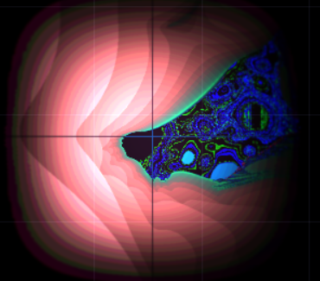

Slide 4
Sources and interesting videos:
Quora about fractal uses
Benoit Mandelbrot himself talks about fractal uses
Mandelbrot on roughness and fractals

